Slide 1

From Deep Potential to DeePMD-kit, to Deepmodeling
Yifan Li, yifanl@princeton.edu
11/18/2021

Slide 2
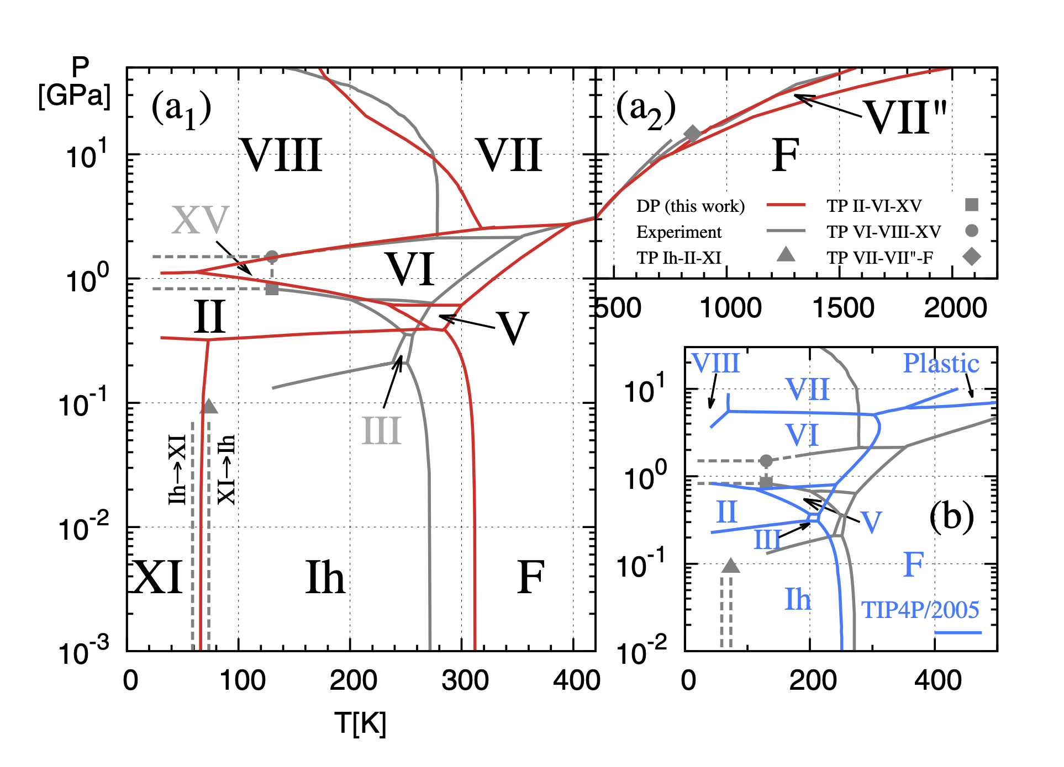
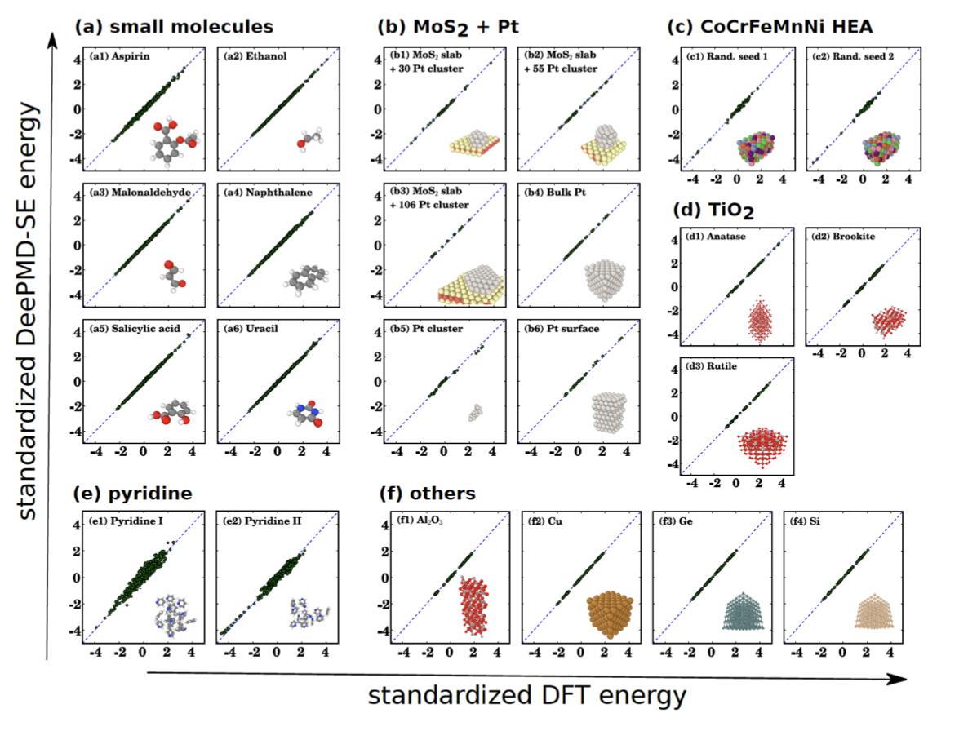
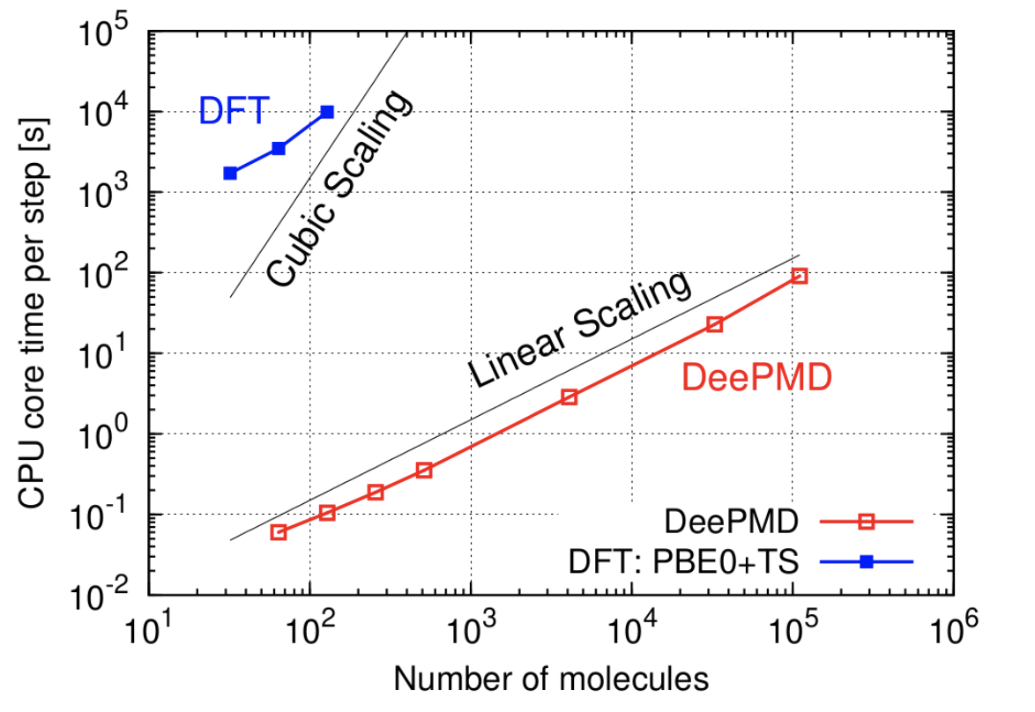
Background and Introduction
Emperical forcefield: fast but not accurate
ab initio molecular dynamics: accurate but slow
Deep Potential model: quantum accuracy with linear scaling
phase diagram of water with DP

Slide 3
Outline
Deep Potential: a deep learning potential energy model
DeePMD-kit: an open-source deep learning package
Software introduction
Hands-on tutorial
Deepmodeling: an open and inclusive community to combine machine learning, physical modeling, and cutting-edge computational platforms

Slide 4
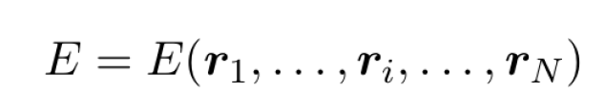
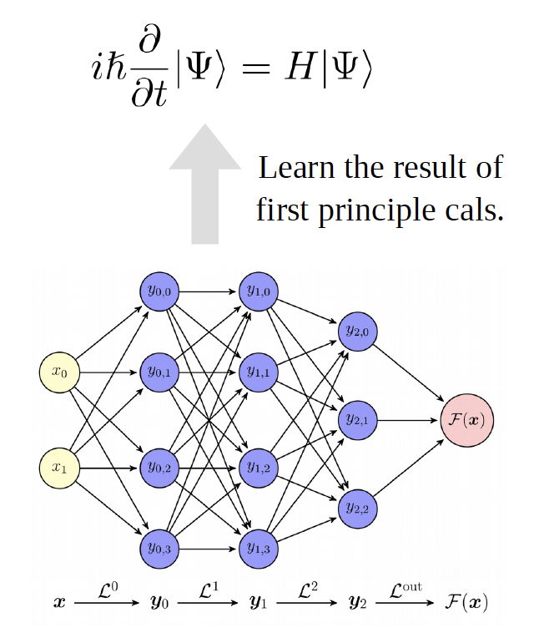
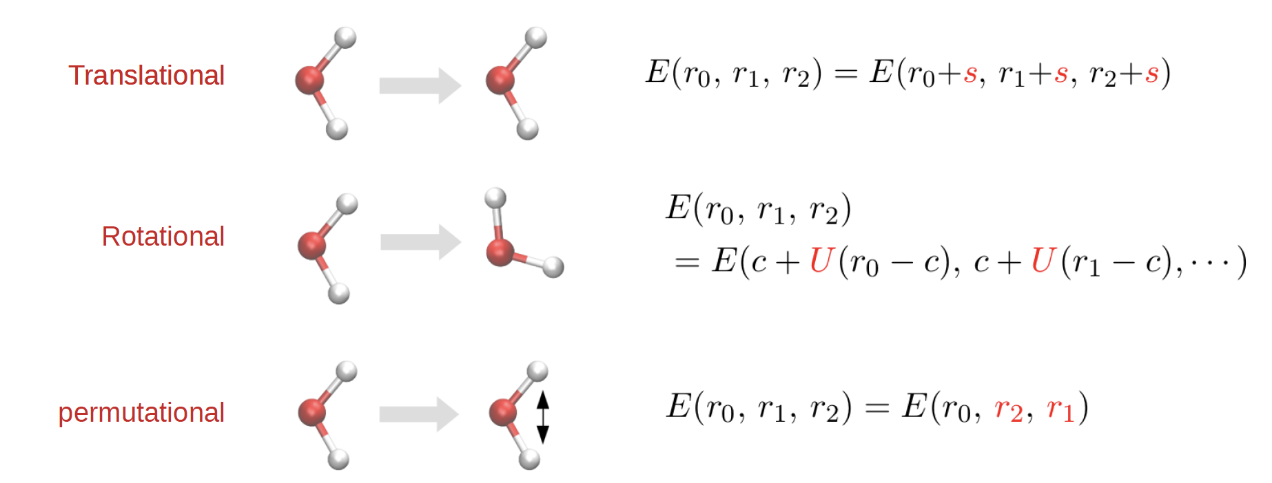
The Symmetry-preserving Model
A good model should preserve the following symmetries:

Slide 5
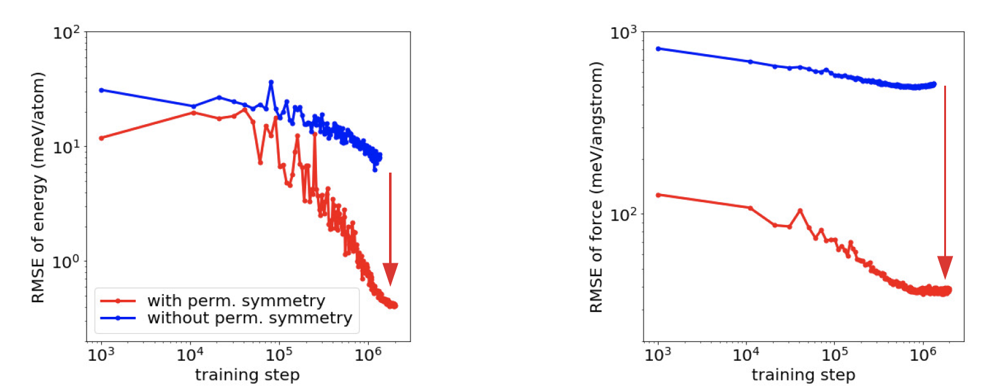
Preserveing Symmetries Leads to Lower Training Loss

Slide 6
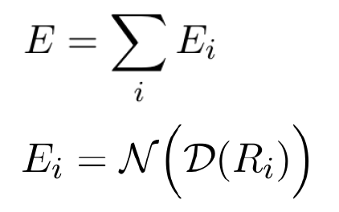
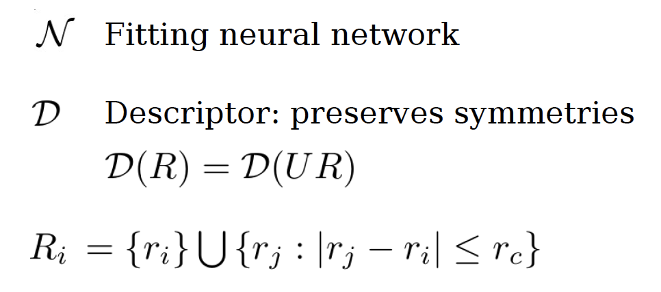
Model Construction
The total energy is decomposed into atomic contributions:
The symmetry-preserving descriptor is constructed by an embedding net, and then the atomic energy is obtained from a fitting net.

Slide 7
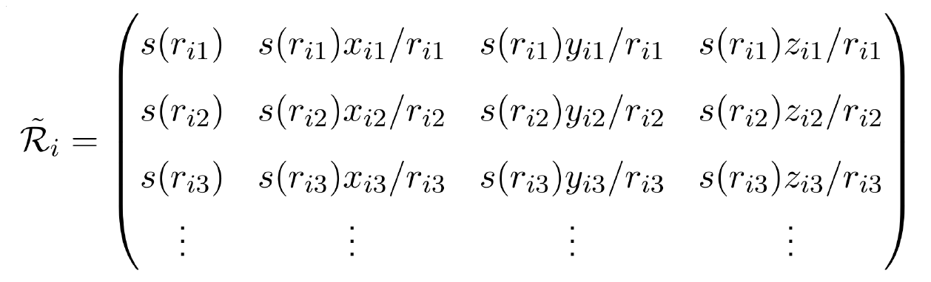
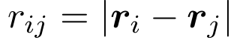
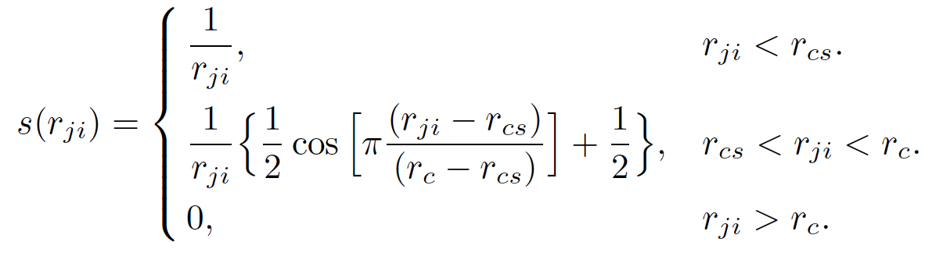
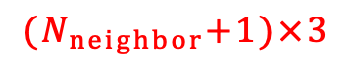
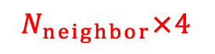
Network Structure of the Model (I)
smooth edition
Weighting function:
Coordinate → environmental matrix
$${(N}_{neighbor}+1)×3$$
$$N_{neighbor}×4$$
translational invariance
weighting function

Slide 8
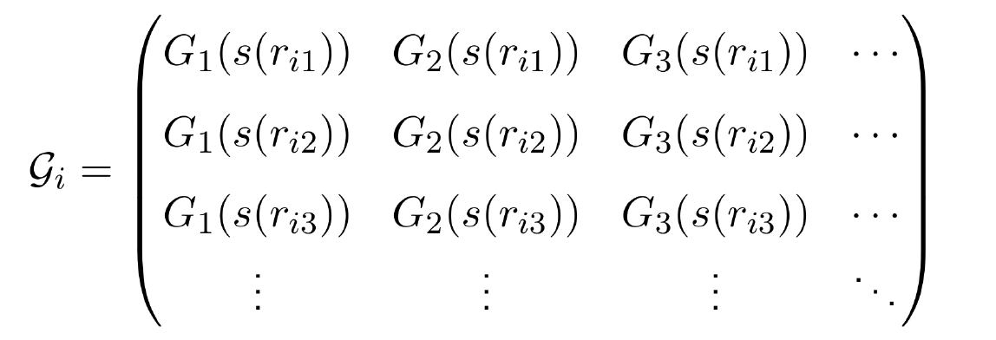
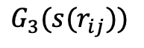

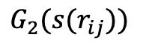
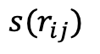
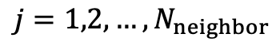
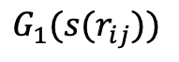


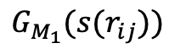
Network Structure of the Model (II)
Embedding network:
Weighting function → local embedding matrix
$N_{neighbor}×1$ single values
${N_{neighbor}×M}_{1}$ outputs
$$G_{1}({s(r}_{ij}))$$
an embedding network with trainable parameters
$$G_{2}({s(r}_{ij}))$$
$${s(r}_{ij})$$
$$G_{3}({s(r}_{ij}))$$
$$j=1,2,…,N_{neighbor}$$
$$⋮$$
$$G_{M_{1}}({s(r}_{ij}))$$

Slide 9
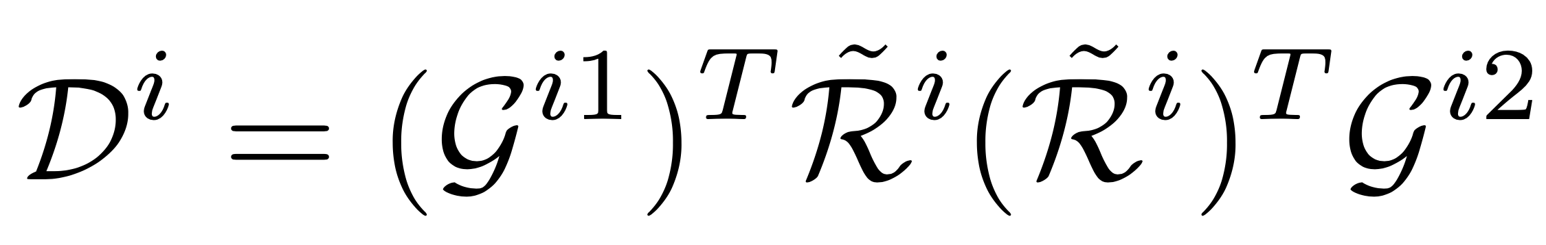
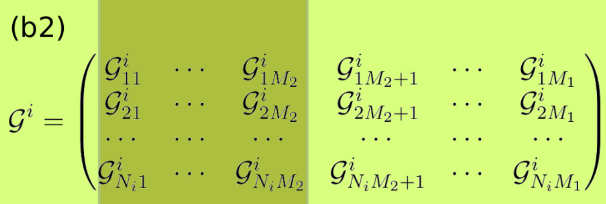
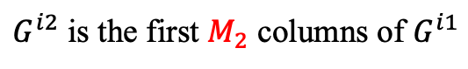
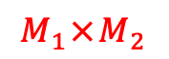
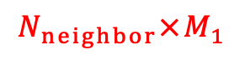
Network Structure of the Model (III)
Matrix multiplication:
Embedding matrix → descriptor
$${N_{neighbor}×M}_{1}$$
$${M_{1}×M}_{2}$$
$G^{i2}$ is the first $M_{2}$ columns of $G^{i1}$
Rotational invariance:

Slide 10
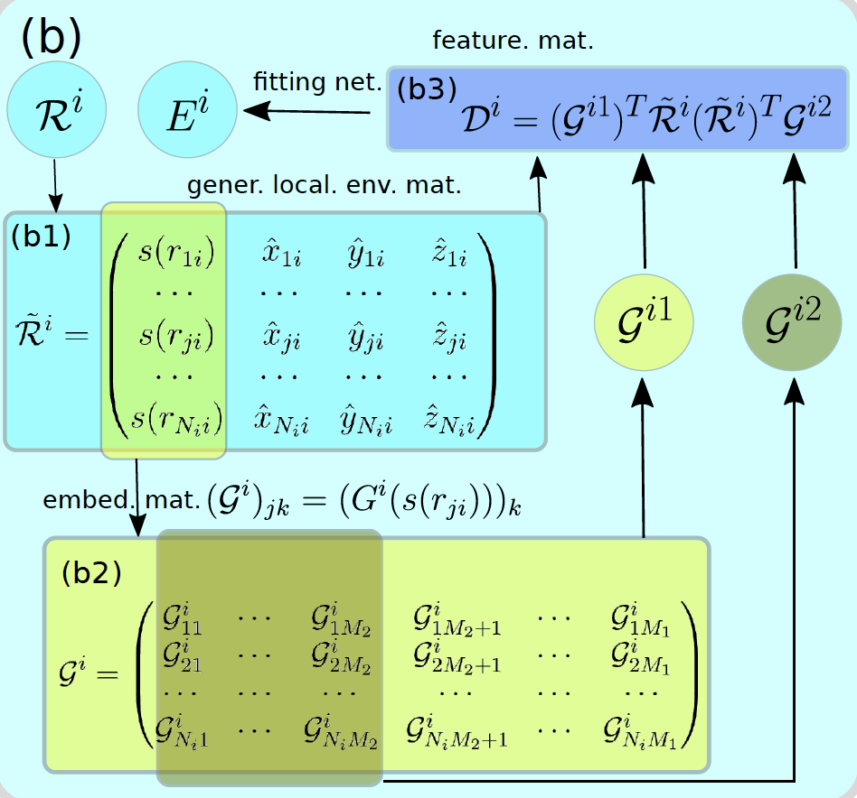
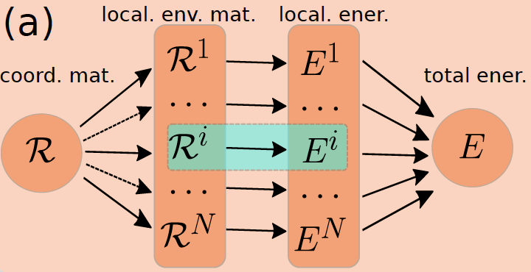
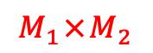
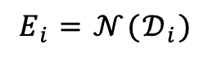
Network Structure of the Model (IV)
Fitting net
Overview
Descriptor → energy
$${M_{1}×M}_{2}$$
scalar
$$E_{i}=𝒩(𝒟_{i})$$

Slide 11
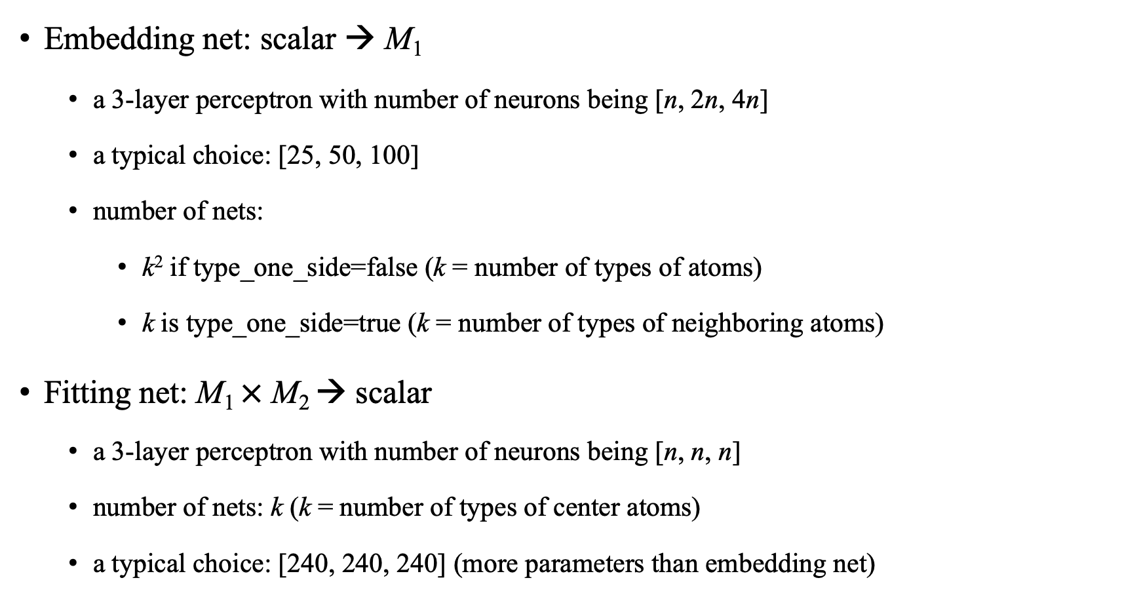
Network stucture
Embedding net: scalar → M₁
a 3-layer perceptron with number of neurons being [n, 2n, 4n]
a typical choice: [25, 50, 100]
number of nets:
k² if type_one_side=false (k = number of types of atoms)
k is type_one_side=true (k = number of types of neighboring atoms)
Fitting net: M₁ $×$ M₂ → scalar
a 3-layer perceptron with number of neurons being [n, n, n]
number of nets: k (k = number of types of center atoms)
a typical choice: [240, 240, 240] (more parameters than embedding net)

Slide 12
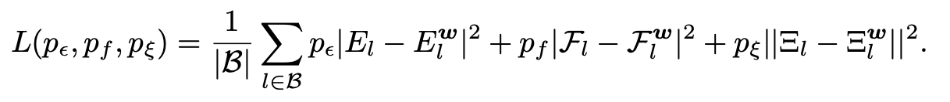
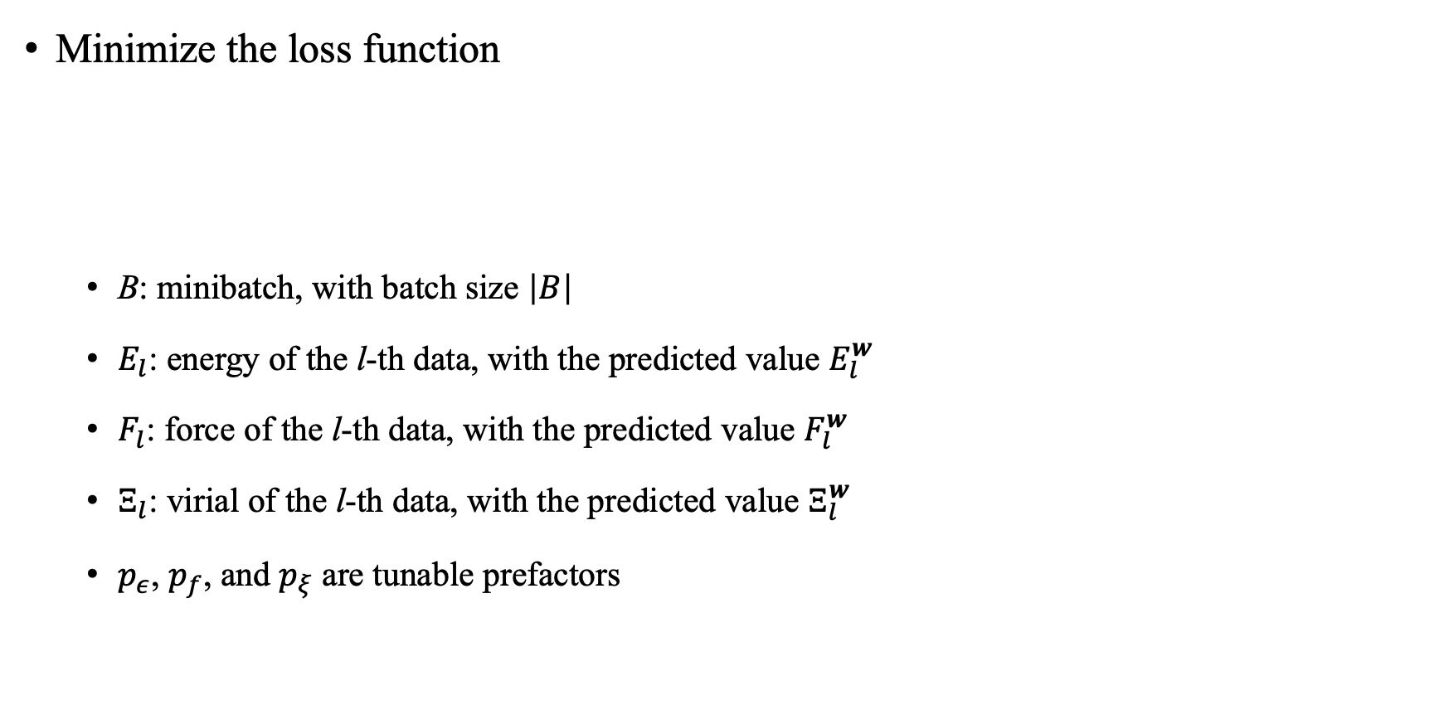
Model Training
Minimize the loss function
B: minibatch, with batch size $\left|B\right|$
$E_{l}$: energy of the l-th data, with the predicted value $E_{l}^{w}$
$F_{l}$: force of the l-th data, with the predicted value $F_{l}^{w}$
$Ξ_{l}$: virial of the l-th data, with the predicted value $Ξ_{l}^{w}$
$p_{ε}$, $p_{f}$, and $p_{ξ}$ are tunable prefactors

Slide 13
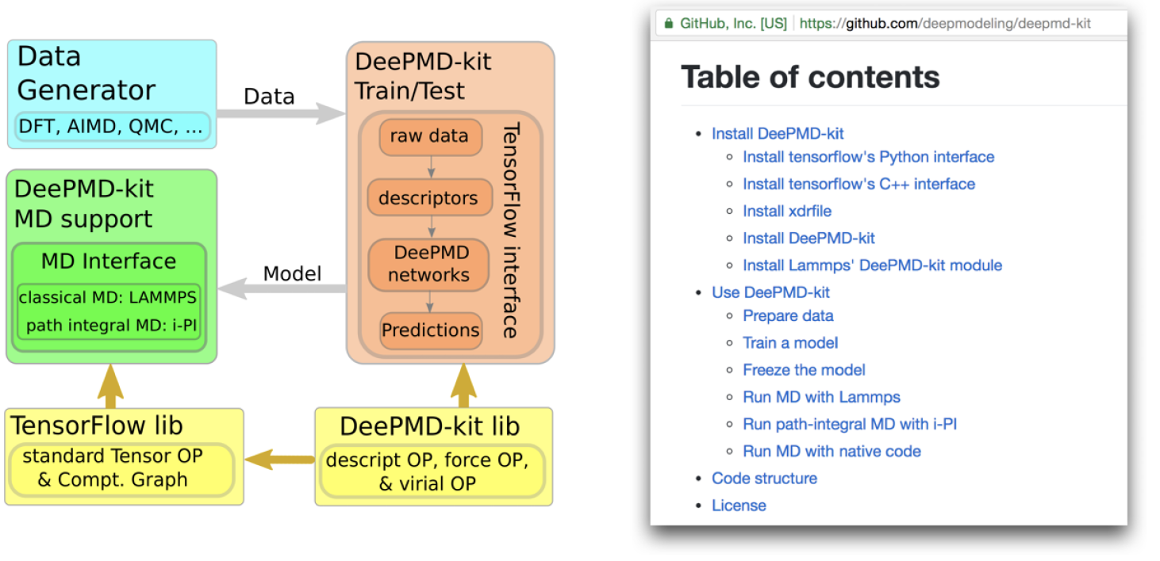
DeePMD-kit
v2.0.3 released on Oct. 14, 2021
Now supports LAMMPS, GROMACS, OPENMM, and i-PI

Slide 14
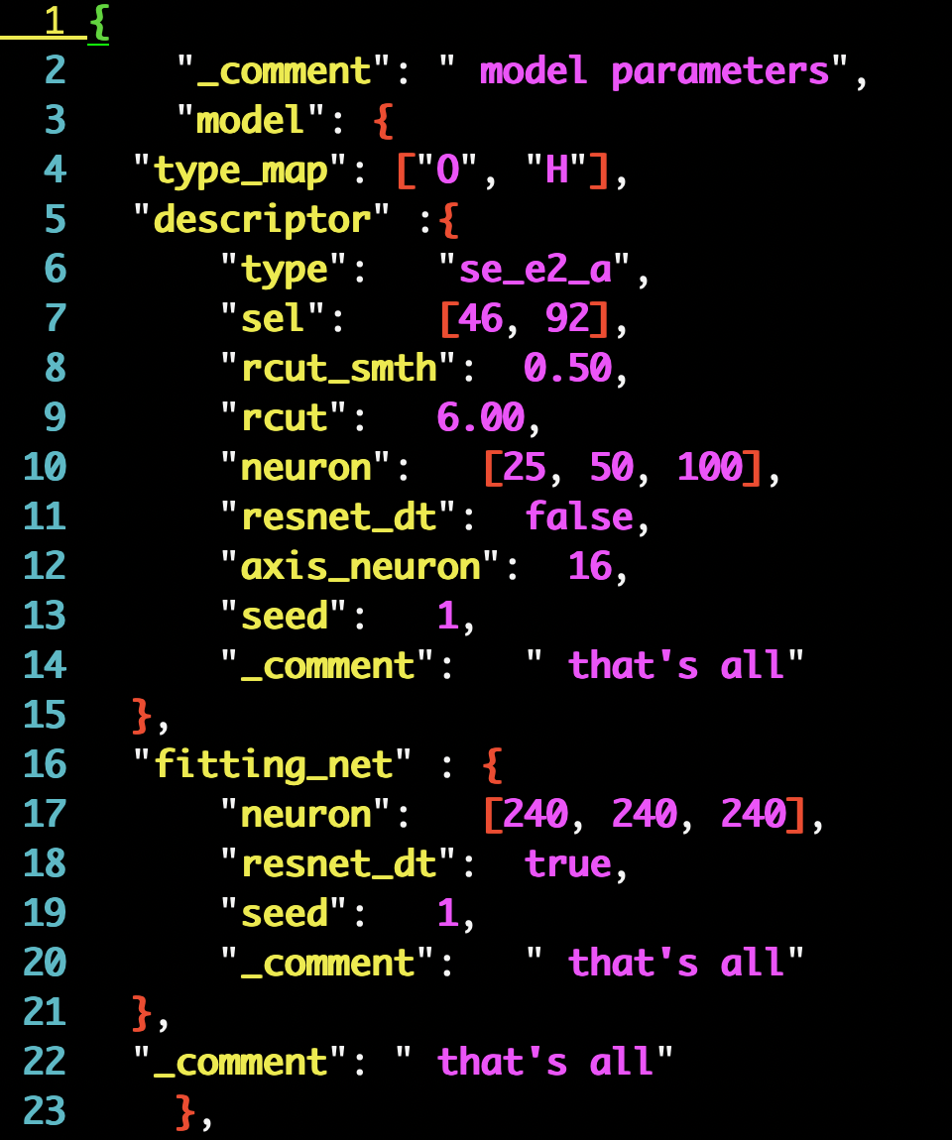
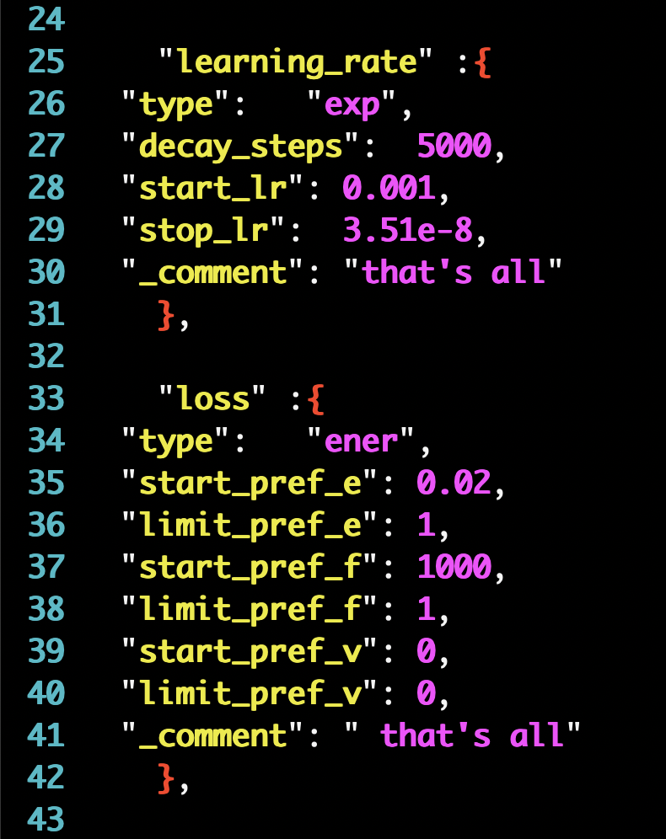
Input scripts
Embedding net and fitting net
Training options

Slide 15
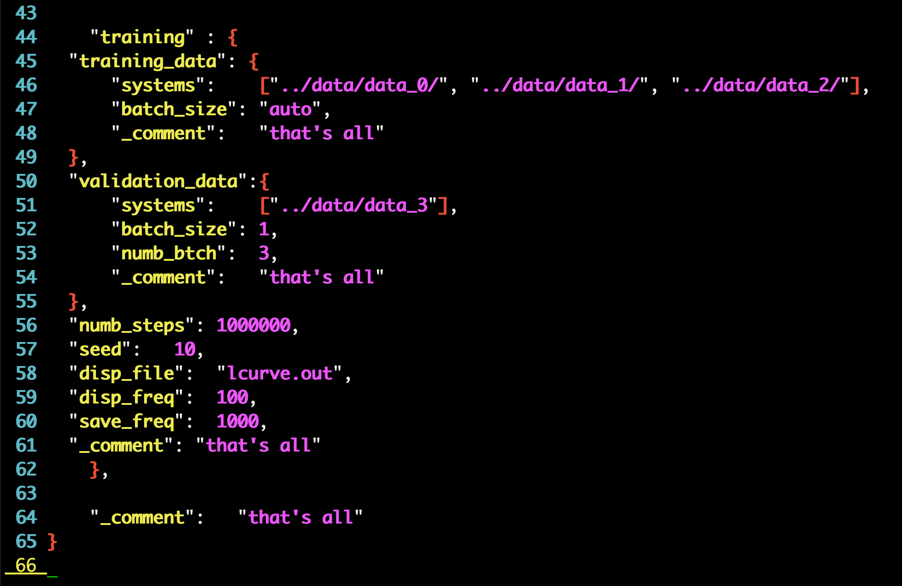
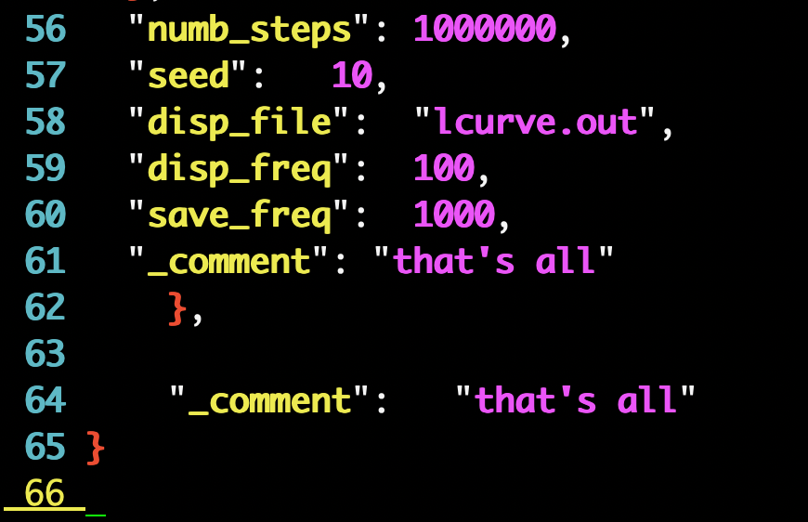
Training Input Script
Specifying dataset
Training options

Slide 16
A Typical Workflow of Using DeePMD-kit
Generate training data: first-principle calculations / DP-GEN
Convert data format: dpdata
Train and freeze the model: dp train, dp freeze
Test the model: dp test
Compress the model: dp compress
Run molecular dynamics and compute properties of interest: lmp / gmx / …
Hands-on session! : )
Download data and model: explore DP Library!
https://dplibrary.deepmd.net//#/

Slide 17
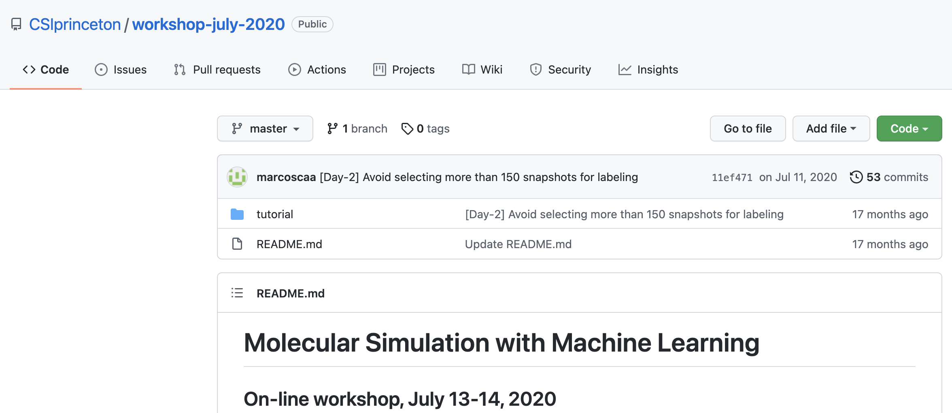
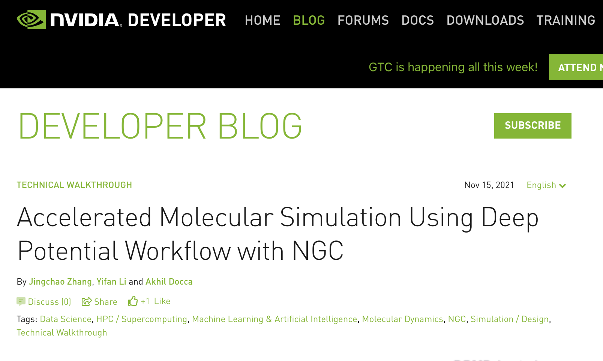
Other Resources
A Hands-on tutorial: https://github.com/CSIprinceton/workshop-july-2020
day1: DP-GEN
day2: DP + PLUMED
A Tutorial blog specifically for graphene:
https://developer.nvidia.com/blog/accelerated-molecular-simulation-using-deep-potential-workflow-with-ngc/
https://github.com/deepmodeling/SC21_DP_Tutorial
Email me at yifanl@princeton.edu for any questions!

Slide 18
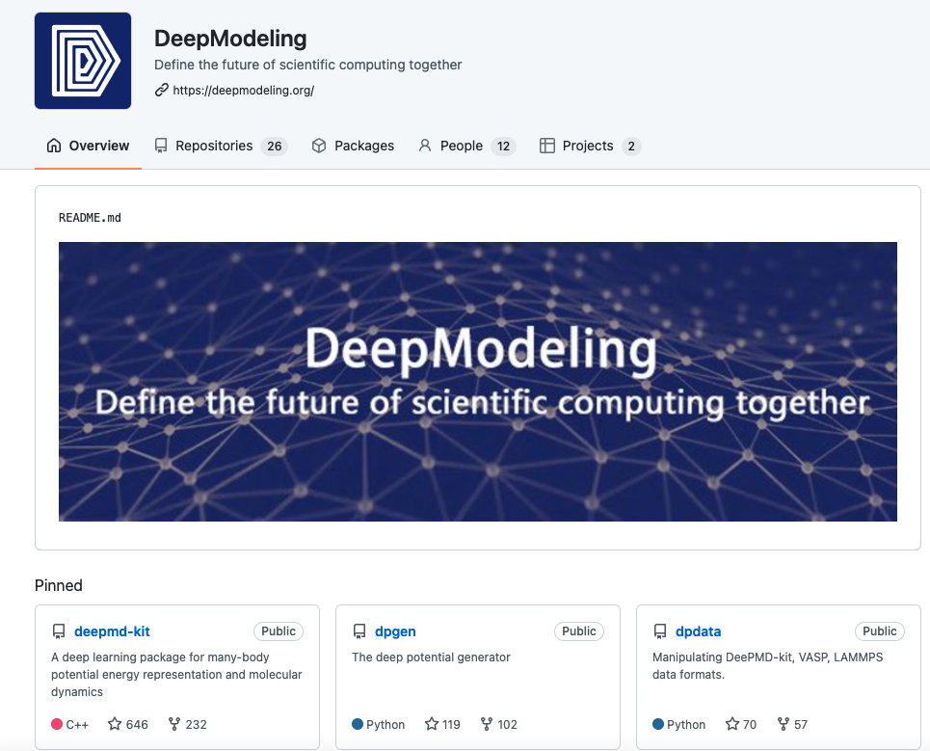
DeepModeling Community

Slide 19
Original Literatures
Deep potential model:
Han et al, Commun. Comput. Phys. (2018) Deep Potential: A General Representation of a Many-Body Potential Energy Surface
Zhang et al, Adv. Neural Inf. Process. Syst. (2018) End-to-end symmetry preserving inter-atomic potential energy model for finite and extended systems
Zhang et al, Phys. Rev. Lett. (2018) Deep Potential Molecular Dynamics: A Scalable Model with the Accuracy of Quantum Mechanics
Lu et al, arXiv (2021) DP Train, then DP Compress: Model Compression in Deep Potential Molecular Dynamics
DeePMD-kit software:
Wang et al, Comput. Phys. Commun. (2018) DeePMD-kit: A deep learning package for many-body potential energy representation and molecular dynamics
github: https://github.com/deepmodeling/deepmd-kit
Documentation: https://docs.deepmodeling.org/projects/deepmd/en/master/
DP-GEN, a concurrent learning scheme to generate training data:
Zhang et al, Comput. Phys. Commun. (2020) DP-GEN: A concurrent learning platform for the generation of reliable deep learning based potential energy models
DeePMD + HPC:
Jia et al, SC20 (2020) Pushing the Limit of Molecular Dynamics with Ab Initio Accuracy to 100 Million Atoms with Machine Learning
Lu et al, Comput. Phys. Commun. (2021) 86 PFLOPS Deep Potential Molecular Dynamics simulation of 100 million atoms with ab initio accuracy

